Slide 1
SYLLABUS Module 2- Problem Solving
Solving Problems by searching-
Problem solving Agents,
Example problems,
Searching for solutions,
Uninformed search strategies,
Informed search strategies,
Heuristic functions.
CO1: Explain the fundamental concepts of intelligent systems and their architecture. (Cognitive Knowledge Level: Understanding)
CO2: Illustrate uninformed and informed search techniques for problem solving in intelligent systems. (Cognitive Knowledge Level: Understanding)
PO1-Engineering Knowledge
PO2 Problem Analysis
PO12 Life long learning

Slide 2


Slide 3
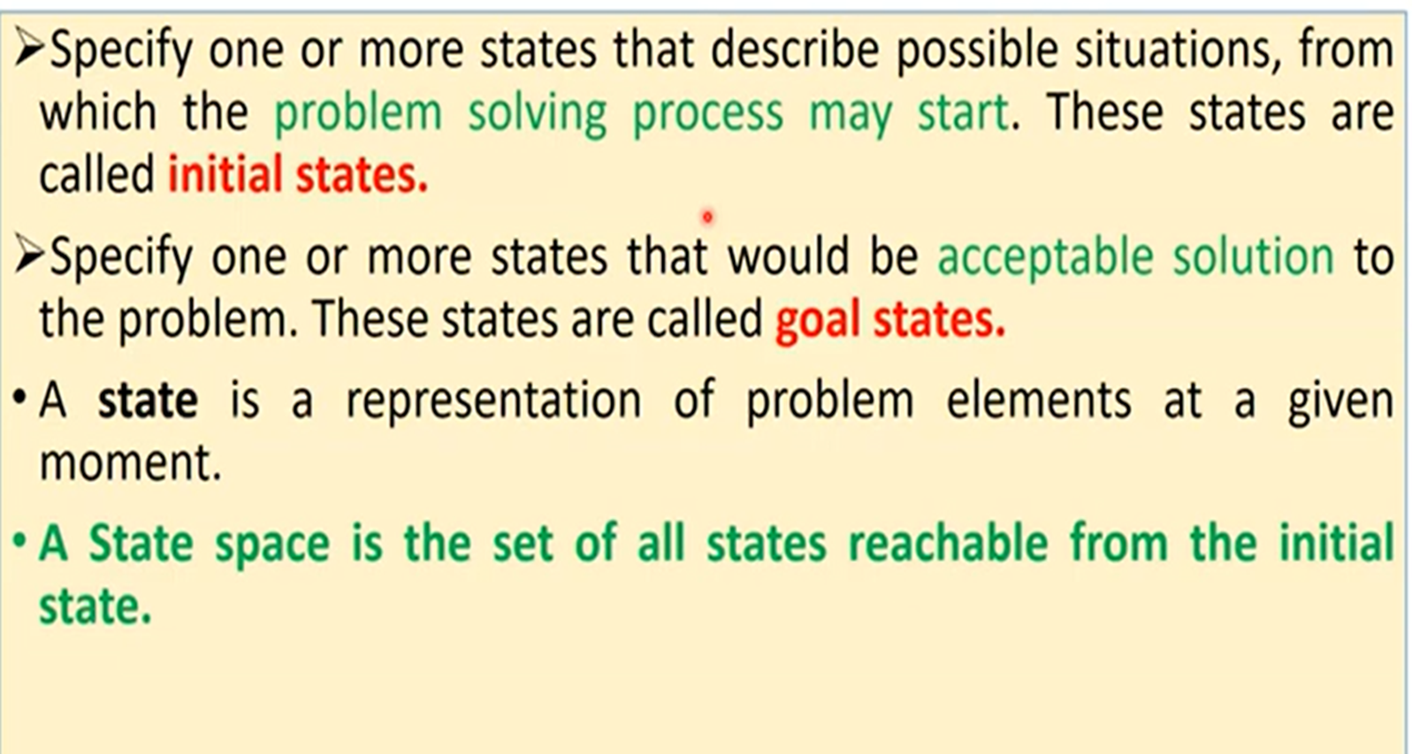

Slide 4
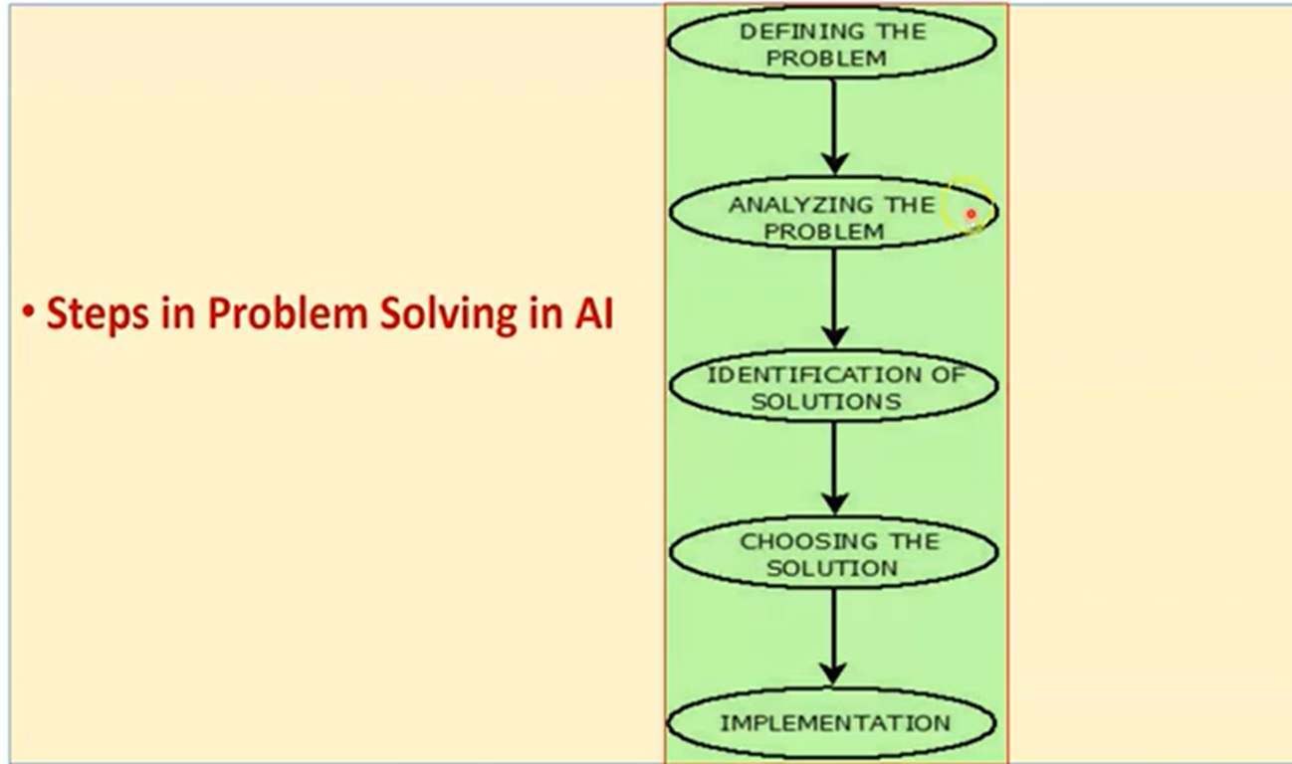

Slide 5
PROBLEM-SOLVING AGENTS
Goal Based Agent
Agent adopt a goal and aim at satisfying them
Goals help organize behavior by limiting the objectives that the agent is trying to achieve and hence the actions it needs to consider

Slide 6
Steps Require to Solve a Problem
Goal Formulation:
It organizes finite steps to formulate a target/goals which require some action to achieve the goal.
based on AI agents.
Problem formulation:
decides what action should be taken to achieve the formulated goal.

Slide 7
Goal formulation
It is based on the current situation and the agent’s performance measure
The goal is formulated
as a set of world states, in which the goal is satisfied
Reaching from initial state → goal state
Actions are required
Actions are the operators
causing transitions between world states
Actions should be abstract enough at a certain degree, instead of very detailed
E.g., turn left VS turn left 30 degree, etc.
With such high level of detail there is too much uncertainty in the world and there would be too many steps in a solution for agent to find a solution

Slide 8
Problem formulation
The process of deciding
what actions and states to consider
E.g., driving Ernakulam to Chennai
in-between states and actions defined
States: Some places in Ernakulam and Chennai
Actions: Turn left, Turn right, go straight, accelerate & brake, etc.
agent will consider actions at the level of driving from one major town to another
Each state therefore corresponds to being in a particular town.

Slide 9
Components to formulate the associated problem
Initial State: This state requires an initial state for the problem which starts the AI agent towards a specified goal. In this state new methods also initialize problem domain solving by a specific class.
Action: This stage of problem formulation works with function with a specific class taken from the initial state and all possible actions done in this stage.
Transition: This stage of problem formulation integrates the actual action done by the previous action stage and collects the final stage to forward it to their next stage.
Goal test: This stage determines that the specified goal achieved by the integrated transition model or not, whenever the goal achieves stop the action and forward into the next stage to determines the cost to achieve the goal.
Path costing: This component of problem-solving numerical assigned what will be the cost to achieve the goal. It requires all hardware software and human working cost.

Slide 10
an agent with several immediate options of unknown value can decide what to do by first examining future actions that eventually lead to states of known value.

Slide 11
Properties of the Environment
properties of the environment
Observable: agent always knows the current state
Discrete: at any given state there are only finitely many actions to choose from
Known: agent knows which states are reached by each action.
Deterministic: each action has exactly one outcome
Under these assumptions, the solution to any problem is a fixed sequence of actions

Slide 12
Search
The process of looking for a sequence of actions that reaches the goal is called search
A search algorithm takes a problem as input and returns a solution in the form of an action sequence
Once a solution is found, the actions it recommends can be carried out. This is called the execution phase
Agent has a “formulate, search, execute” design

Slide 13
Searching Process
Formulate a goal and a problem to solve,
the agent calls a search procedure to solve it
Agent uses the solution to guide its actions,
do whatever the solution recommends
remove that step from the sequence.
Once the solution has been executed, the agent will formulate a new goal.

Slide 14
Open-loop system
while the agent is executing the solution sequence it ignores its percepts when choosing an action because it knows in advance what they will be
An agent that carries out its plans with its eyes closed, so to speak, must be quite certain of what is going on is an open loop.
ignoring the percepts breaks the loop between agent and environment.

Slide 15
Well-defined problems and solutions
A problem can be defined formally by following components:
The initial state that the agent starts in
A description of the possible actions available to the agent.
Given a particular state s, ACTIONS(s) returns the set of actions that can be executed in s. We say that each of these actions is applicable in s.
For example, from the state In(Ernakulam), the applicable actions are {Go(Thrissur), Go(Palakkad), Go(Kozhikod)}.
Transition model: description of what each action does, specified by a function RESULT(s, a) that returns the state that results from doing action a in state s
Successor: any state reachable from a given state by a single action
RESULT(In(Ernakulam),Go(Thrissur)) = In(Thrissur) .
state space: the set of all states reachable from the initial state by any sequence of actions. forms a directed network or graph in which the nodes are states and the links between nodes are actions.

Slide 16
A path in the state space is a sequence of states connected by a sequence of actions
The goal test, which determines whether a given state is a goal state {In(Chennai)}
A path cost function that assigns a numeric cost to each path
cost of a path can be described as the sum of the costs of the individual actions along the path.
The step cost of taking action a in state s to reach state s is denoted by c(s, a, s ).
A solution to a problem is an action sequence that
leads from the initial state to a goal state.
Solution quality is measured by the
path cost function, and an optimal solution has
the lowest path cost among all solutions

Slide 17
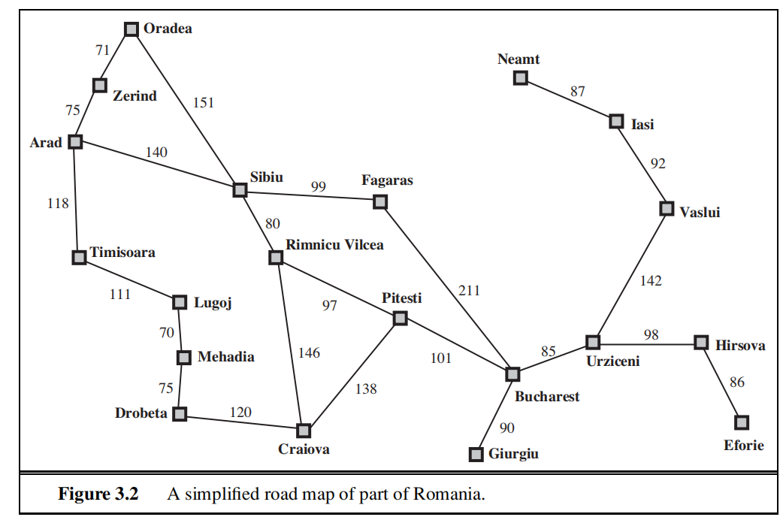

Slide 18
Formulating problems
Anything else besides the four components for problem formulation
Abstraction
the process to take out the irrelevant information
leave the most essential parts to the description of the states
( Remove detail from representation)
Conclusion: Only the most important parts that are contributing to searching are used
The choice of a good abstraction thus involves removing as much detail as possible while retaining validity and ensuring that the abstract actions are easy to carry out.
Were it not for the ability to construct useful abstractions, intelligent agents would be completely swamped by the real world.

Slide 19
Evaluation Criteria
formulation of a problem as search task
basic search strategies
important properties of search strategies
selection of search strategies for specific tasks
(The ordering of the nodes in FRINGE defines the search strategy)

Slide 20
Problem-Solving Agents
agents whose task is to solve a particular problem (steps)
goal formulation
what is the goal state
what are important characteristics of the goal state
how does the agent know that it has reached the goal
are there several possible goal states
are they equal or are some more preferable
problem formulation
what are the possible states of the world relevant for solving the problem
what information is accessible to the agent
how can the agent progress from state to state

Slide 21
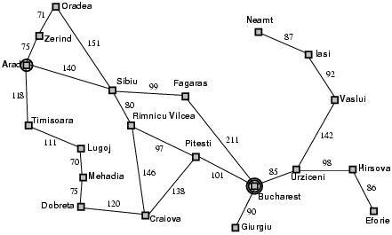
Example: Romania
On holiday in Romania; currently in Arad.
Flight leaves tomorrow from Bucharest
Formulate goal:
be in Bucharest
Formulate problem:
states: various cities
actions: drive between cities
Find solution:
sequence of cities, e.g., Arad, Sibiu, Fagaras, Bucharest

Slide 23
Problem : To Go from Arad to Bucharest
Initial State : Arad
Operator : Go from One City To another .
State Space : {Sibiu, Fagaras, Timisora,….}
Goal Test : are the agent in Bucharest.
Path Cost Function : Get The Cost From The Map.
Solution :{ {Ar → sib → Fr→Bu} , {Ar →Ti → Lu → Me → Cr,→Pi→Bu} …..}
State Set Space : {Arad → Sibiu → Fagaras → Bucharest}

Slide 24
Single-state problem formulation
A problem is defined by four items:
. initial state e.g., "at Arad"
actions or successor function S(x) = set of action–state pairs
e.g., S(Arad) = {<Arad → Zerind, Zerind>, … }
goal test, can be
explicit, e.g., x = "at Bucharest"
implicit, e.g., Checkmate(x)
path cost (additive)
e.g., sum of distances, number of actions executed, etc.
c(x,a,y) is the step cost, assumed to be ≥ 0
A solution is a sequence of actions leading from the initial state to a goal state

Slide 25
Example Problems
Distinguishing between toy and real-world problems
Toy Problem is intended to illustrate or exercise various problem-solving methods. E.g., puzzle, chess, etc.
A real-world problem is one whose solutions people actually care about. E.g., Design, planning, etc.

Slide 26
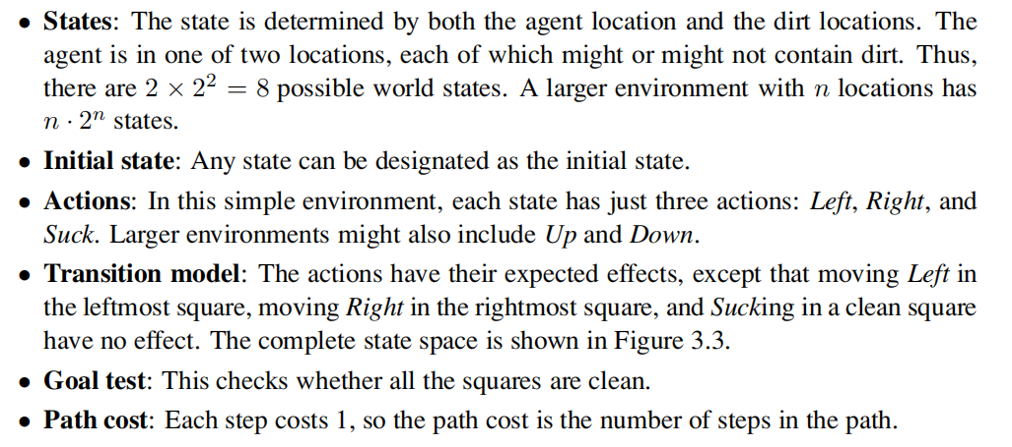
Toy problems- Vacuum World
Compared with the real world, this toy problem has discrete locations, discrete dirt, reliable
cleaning, and it never gets any dirtier.

Slide 27
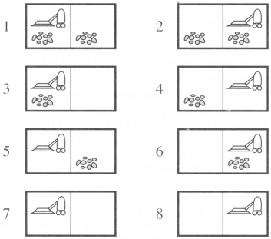
Number of states: 8
Initial state: Any
Number of actions: 4
left, right, suck, noOp
Goal: clean up all dirt
Goal states: {7, 8}
Path Cost:
Each step costs 1

Slide 28
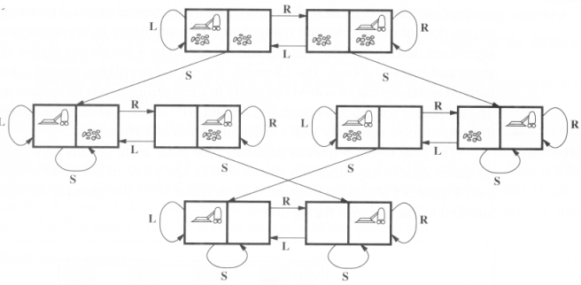

Slide 29
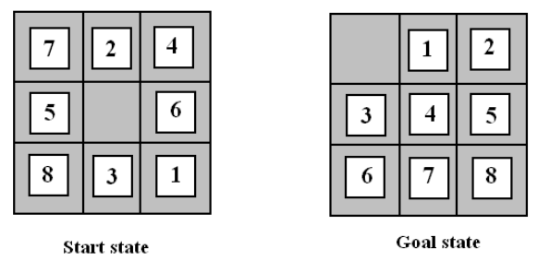
8-puzzle
A tile adjacent to the blank space can slide into the space. The object is to reach a specified goal state

Slide 30
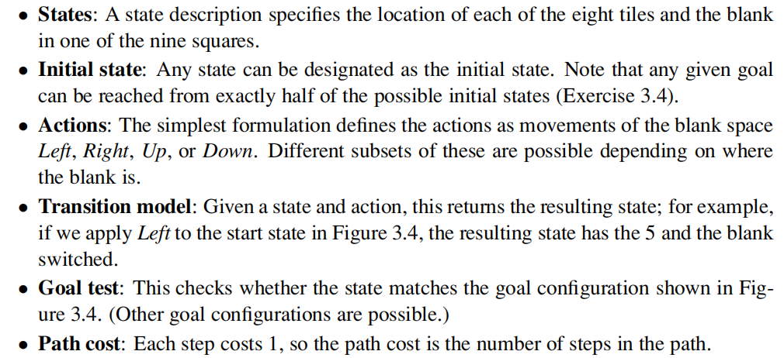

Slide 31
The 8-puzzle has 9!/2 = 181, 440 reachable states and is easily solved.
The 15-puzzle (on a 4×4 board) has around 1.3 trillion states, and random instances can be solved optimally in a few milliseconds by the best search algorithms.
The 24-puzzle (on a 5 × 5 board) has around 1025 states, and random instances take several hours to solve optimally.

Slide 32
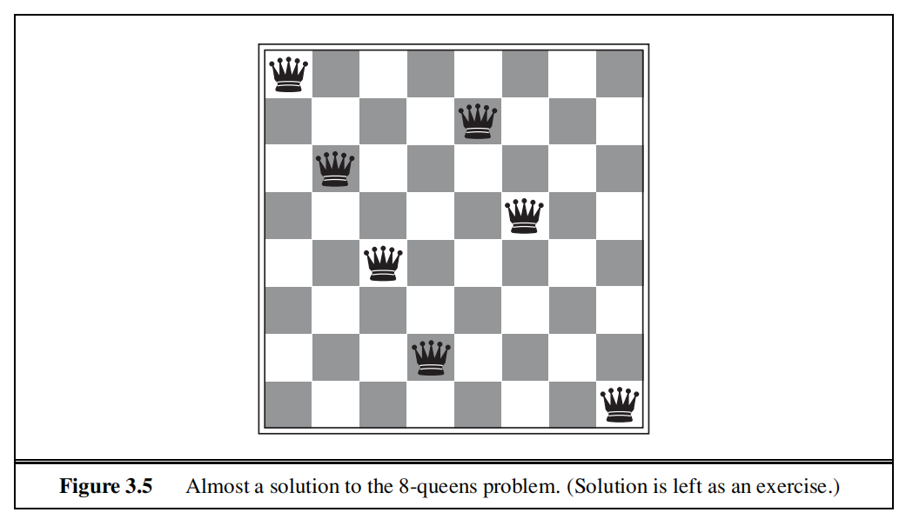
8-queens problem
The goal of the 8-queens problem is to place eight queens on a chessboard such that no queen attacks any other.
A queen attacks any piece in the same row, column or diagonal.

Slide 33
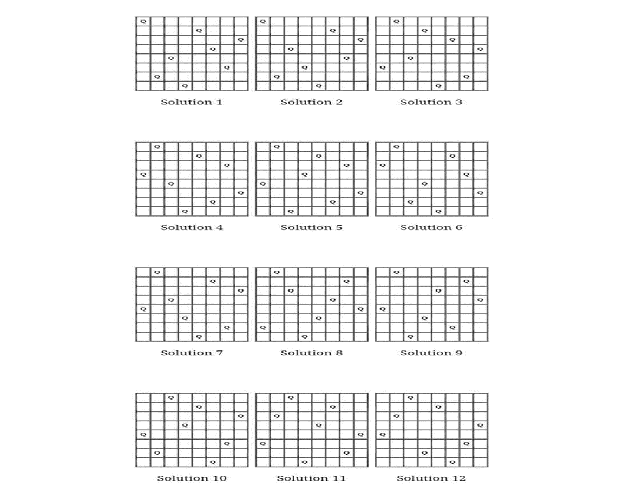

Slide 34
There are two main kinds of formulation
An incremental formulation
involves operators that augment the state description starting from an empty state
Each action adds a queen to the state
States:
any arrangement of 0 to 8 queens on board
Successor function:
add a queen to any empty square
A complete-state formulation
starts with all 8 queens on the board
move the queens individually around
States:
any arrangement of 8 queens, one per column in the leftmost columns
Operators: move an attacked queen to a row, not attacked by any other
the right formulation makes a big difference to the size of the search space

Slide 35
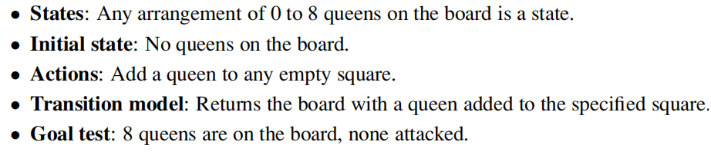
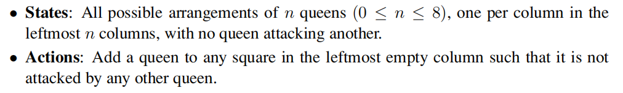
Incremental formulation
In this formulation, we have 64 · 63 ··· 57 ≈ 1.8 × 1014 possible sequences to investigate. A better formulation would prohibit placing a queen in any square that is already attacked:
This formulation reduces the 8-queens state space from 1.8 × 1014 to just 2,057, and solutions are easy to find. On the other hand, for 100 queens the reduction is from roughly 10400 states to about 1052 states (Exercise 3.5)—a big improvement, but not enough to make the problem tractable

Slide 36
Real-world problems- Route-Finding problem
Route-finding problems
Touring problems
Traveling Salesman problem
VLSI layout problem
Robot navigation
Automatic assembly sequencing
Internet searching

Slide 37
Searching for solution
A solution is an action sequence, so search algorithms work by considering various possible action sequences.
The possible action sequences starting at the initial state form a search tree with the initial state at the root
The branches are actions and the nodes correspond to states in the state space of the problem.

Slide 38
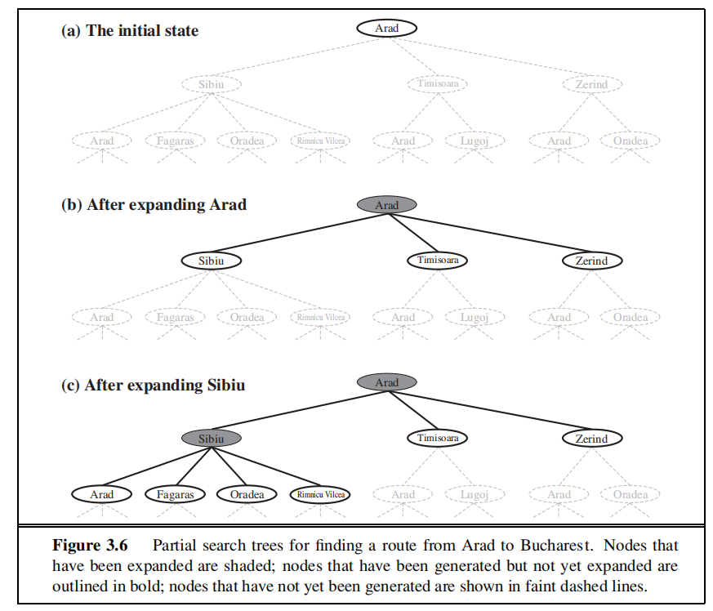
Search tree for finding a route from Arad to Bucharest

Slide 39
Frontier
We reach a state when we identify a path from the start state to it. But, we say that we expanded it if we had followed all its outward edges and reached all its children.
So, we can also think of a search as a sequence of expansions, and we first have to reach a state before expanding it.
Frontier is the reached but unexpanded states because we can expand only them

Slide 40
The root node of the tree corresponds to the initial state, In(Arad).
The first step is to test whether this is a goal state.
Then we need to consider taking various actions. We do this by expanding the current state;
applying each legal action to the current state, thereby generating a new set of states.
In this case, we add three branches from the parent node In(Arad) leading to three new child nodes: In(Sibiu), In(Timisoara), and In(Zerind).
Now we must choose which of these three possibilities to consider further.
The process of expanding nodes on the frontier continues until either a solution is found or there are no more states to expand.
search strategy: how they choose which state to expand next

Slide 41
loopy path: path from Arad to Sibiu and back to Arad again! We say that In(Arad) is a repeated state in the search tree, generated in this case by a loopy path
Considering such loopy paths means that the complete search tree for Romania is infinite because there is no limit to how often one can traverse a loop
loops can cause certain algorithms to fail, making otherwise solvable problems unsolvable.
there is no need to consider loopy paths.
We can rely on more than intuition for this: because path costs are additive and step costs are nonnegative, a loopy path to any given state is never better than the same path with the loop removed.
redundant paths: exist whenever there is more than one way to get from one state to another eg, the paths
Arad–Sibiu (140 km long) and Arad–Zerind–Oradea–Sibiu (297 km long).

Slide 42
a search strategy has two components:
rule(s) to decide whether or not to place the node in the frontier
rule(s) to choose the next frontier node for expansion

Slide 43
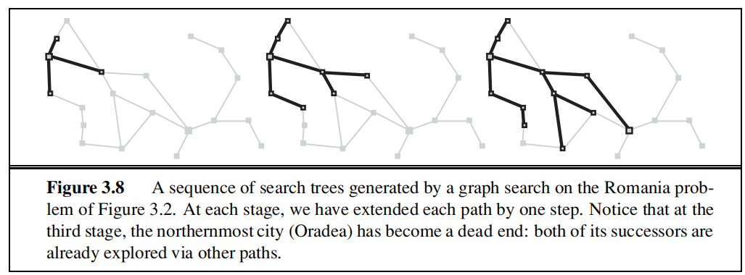
TREE-SEARCH algorithm
with a data structure called the explored set (also known as the closed list), which remembers every expanded node.
Newly generated nodes that match previously generated nodes ones in the explored set or the frontier can be discarded instead of being added to the frontier
ORADEA

Slide 44
GRAPH-SEARCH algorithm
Each state appears in the graph only once. But, it may appear in the tree multiple times
contains at most one copy of each state, so we can think of it as growing a tree directly on the state-space graph,
Don’t add a node if its state has already been expanded or a node pointing to the same state is already in the frontier.
so that every path from the initial state to an unexplored state has to pass through a state in the frontier.
As every step moves a state from the frontier into the explored region while moving some states from the unexplored region into the frontier,
we see that the algorithm is systematically examining the states in the state space, one by one, until it finds a solution.

Slide 45
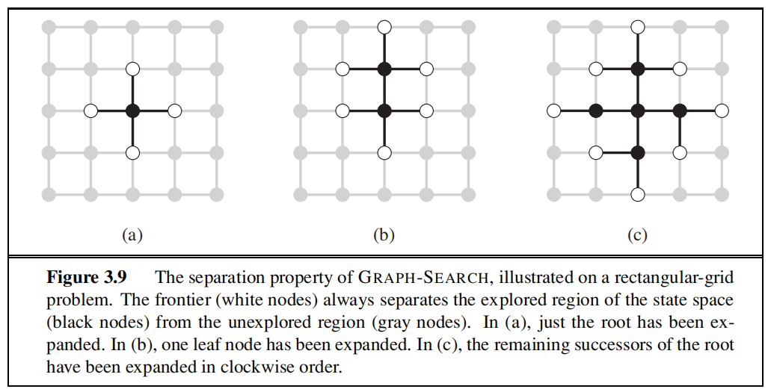

Slide 46
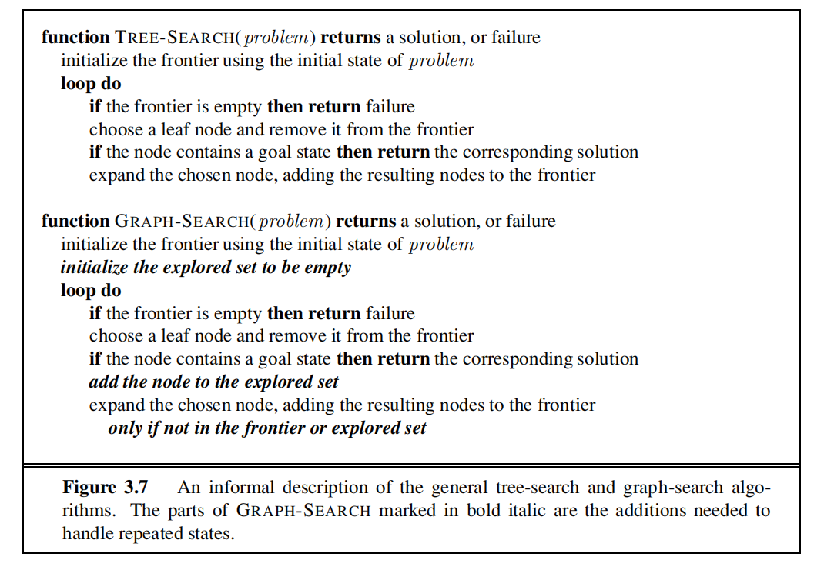

Slide 47
Infrastructure for search algorithms
Search algorithms require a data structure to keep track of the search tree that is being constructed. For each node n of the tree, we have a structure that contains four components:
n.STATE: the state in the state space to which the node corresponds;
n.PARENT: the node in the search tree that generated this node;
n.ACTION: the action that was applied to the parent to generate the node;
n.PATH-COST: the cost, traditionally denoted by g(n), of the path from the initial state to the node, as indicated by the parent pointers.

Slide 48
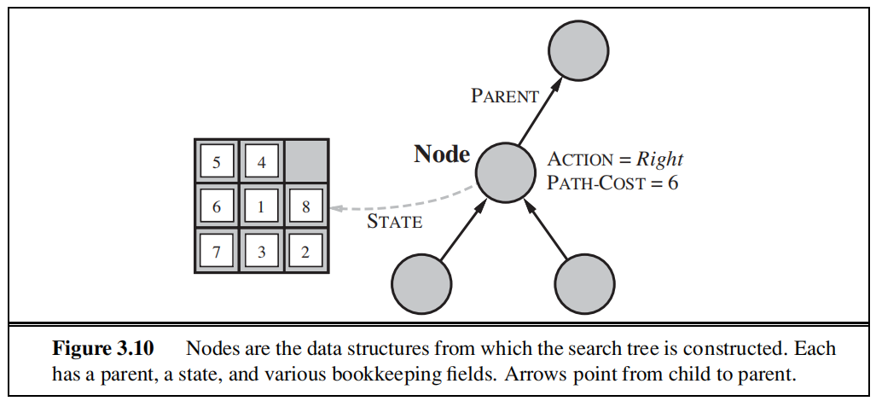

Slide 49
PARENT pointers string the nodes together into a tree structure.
These pointers also allow the solution path to be extracted when a goal node is found;
we use the SOLUTION function to return the sequence of actions obtained by following parent pointers back to the root.
A node is a bookkeeping data structure used to represent the search tree.
A state corresponds to a configuration of the world.
nodes are on particular paths, as defined by PARENT pointers, whereas states are not.
Two different nodes can contain the same world state if that state is generated via two different search paths.

Slide 50
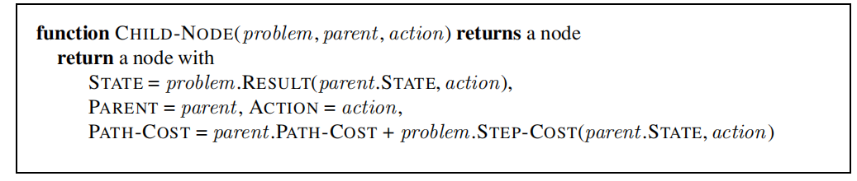
Given the components for a parent node, it is easy to see how to compute the necessary components for a child node. The function CHILD-NODE takes a parent node and an action and returns the resulting child node:

Slide 51
Measuring problem-solving performance
We can evaluate an algorithm’s performance in four ways:
• Completeness: Is the algorithm guaranteed to find a solution when there is one?
• Optimality: Does the strategy find the optimal solution?
• Time complexity: How long does it take to find a solution?
• Space complexity: How much memory is needed to perform the search?
Complexity is expressed in terms of three quantities: b, the branching factor or maximum number of successors of any node; d, the depth of the shallowest goal node and m, the maximum length of any path in the state space.

Slide 52
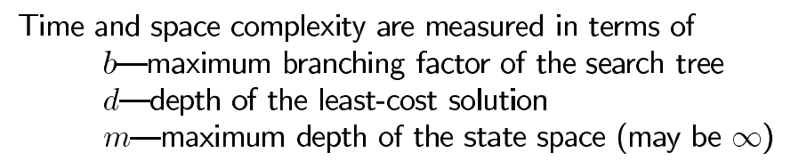

Slide 53
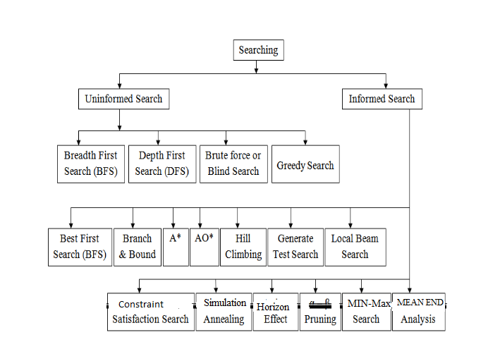
DIFFERENT TYPES OF SEARCHING

Slide 54
Uninformed Search Strategies
no additional information about states beyond that provided in the problem definition
All they can do is generate successors and distinguish a goal state from a non-goal state.
they that do not take into account the location of the goal. These algorithms ignore where they are going until they find a goal and report success.

Slide 55
1. Breadth-First search
root node is expanded first, then all the successors of the root node are expanded next, then their successors, and so on.
all the nodes are expanded at a given depth in the search tree before any nodes at the next level are expanded.
Breadth-first search is an instance of the general graph-search algorithm
in which the shallowest unexpanded node is chosen for expansion
This is achieved very simply by using a FIFO queue for the frontier

Slide 56
new nodes go to the back of the queue, and old nodes, which are shallower than the new nodes, get expanded first
the goal test is applied to each node when it is generated rather than when it is selected for expansion
breadth-first search always has the shallowest path to every node on the frontier

Slide 57
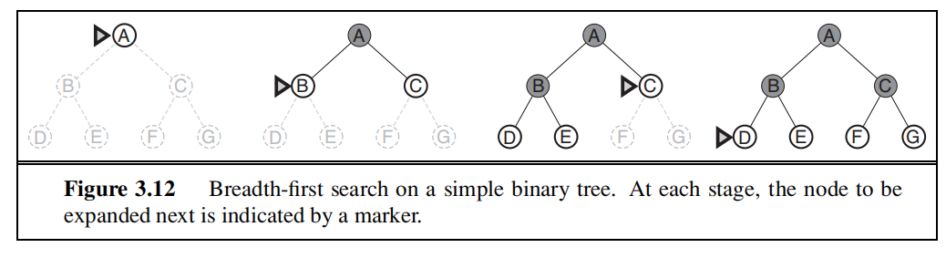

Slide 58
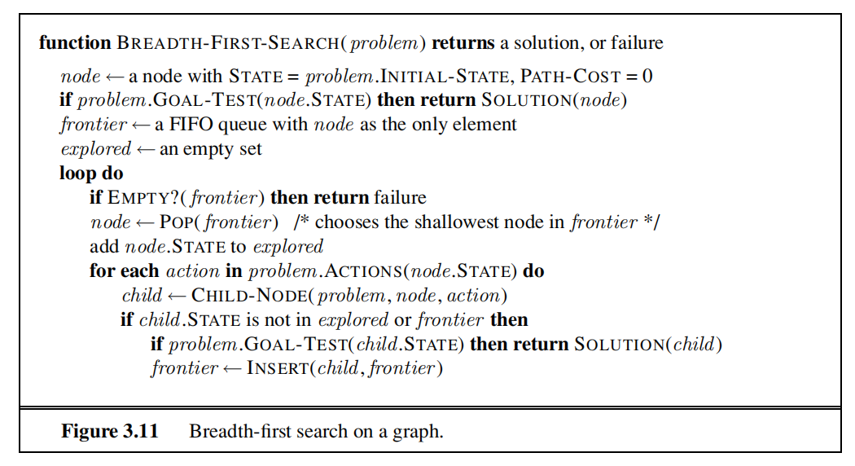

Slide 59
Breadth-first search
S
A
D
B
D
A
E
C
E
E
B
B
F
11
D
F
B
F
C
E
A
C
G
14
17
15
15
13
G
C
G
F
19
19
17
G
25

Slide 60
Problem solving performance-BFS
complete—if the shallowest goal node is at some finite depth d, breadth-first search will eventually find it after generating all shallower nodes
not optimal one: breadth-first search is optimal if the path cost is a nondecreasing function of the depth of the node. The most common such scenario is that all actions have the same cost.
Time Complexity: The root of the search tree generates b nodes at the first level, each of which generates b more nodes, for a total of b2 at the second level. Each of these generates b more nodes, yielding b³ nodes at the third level, and so on. Now suppose that the solution is at depth d. In the worst case, it is the last node generated at that level. Then the total number of nodes generated is
b + b² + b³ + ··· + b^{d} = O(b^{d})
Space Complexity: every node generated remains in memory. There will be O(b^{d−1}) nodes in the explored set and O(b^{d}) nodes in the frontier so the space complexity is O(b^{d}), exponential complexity

Slide 61
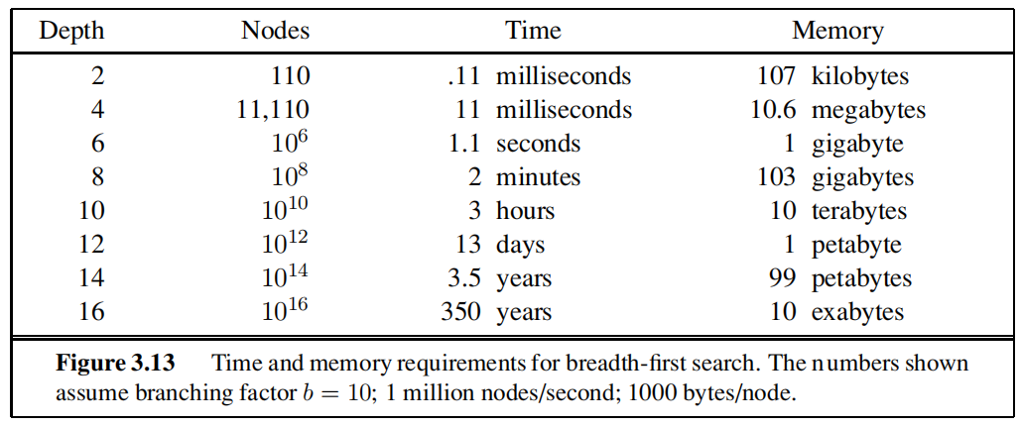

Slide 62
2. Uniform-cost search
Instead of expanding the shallowest node, uniform-cost search expands the node n with the lowest path cost g(n). This is done by storing the frontier as a priority queue ordered by g.
the goal test is applied to a node when it is selected for expansion because the first goal node that is generated may be on a suboptimal path
a test is added in case a better path is found to a node currently on the frontier

Slide 63
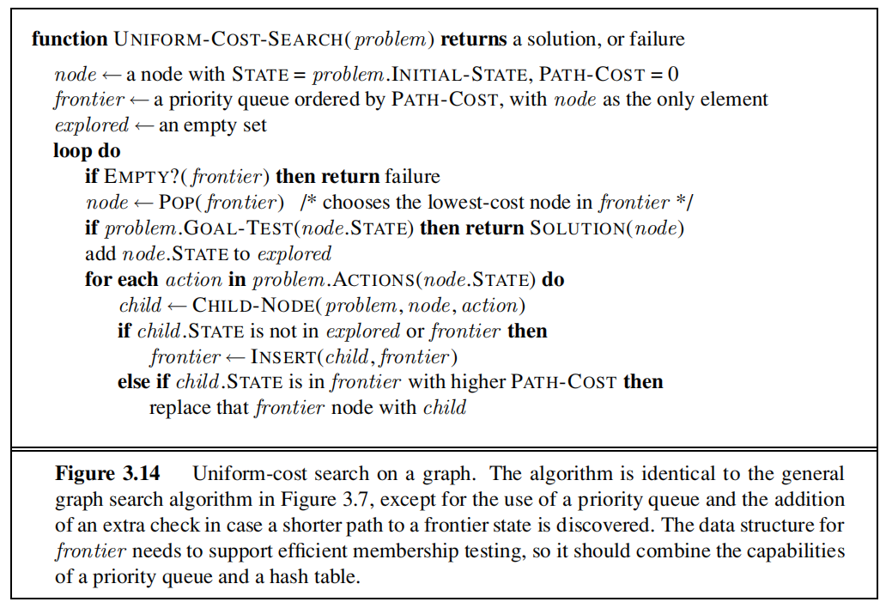

Slide 64
problem is to get from Sibiu to Bucharest
The successors of Sibiu are Rimnicu Vilcea and Fagaras, with costs 80 and 99, respectively.
The least-cost node, Rimnicu Vilcea, is expanded next, adding Pitesti with cost 80 + 97 = 177.
The least-cost node is now Fagaras, so it is expanded, adding Bucharest with cost 99 + 211 = 310.
Now a goal node has been generated, but uniform-cost search keeps going, choosing Pitesti for expansion and adding a second path to Bucharest with cost 80+ 97+ 101 = 278.
Now the algorithm checks to see if this new path is better than the old one; it is, so the old one is discarded. Bucharest, now with g-cost 278, is selected for expansion and the solution is returned.

Slide 65
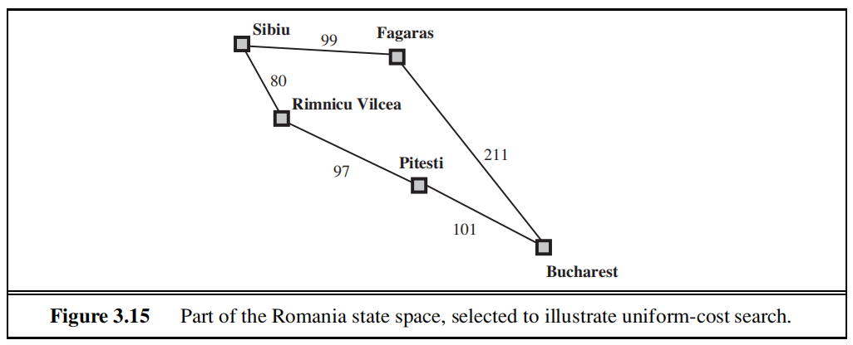

Slide 66
Problem solving performance-UCS
Complete: guaranteed provided the cost of every step exceeds some small positive constant ε
Optimal: optimal path to that node has been found. because step costs are nonnegative, paths never get shorter as nodes are added. uniform-cost search expands nodes in order of their optimal path cost.
Time Complexity: # of nodes with g ≤ cost of optimal solution, O(b^{ceiling(C*/ ε)}) where C* is the cost of the optimal solution
Space Complexity: # of nodes with g ≤ cost of optimal solution, O(b^{ceiling(C*/ ε)})

Slide 67

Uniform-cost search is guided by path costs rather than depths, so its complexity is not easily characterized in terms of b and d.
let C∗ be the cost of the optimal solution and that every action costs at least ε
Then the algorithm’s worst-case time and space complexity is which can be much greater than b^{d}.
This is because uniform cost search can explore large trees of small steps before exploring paths involving large and perhaps useful steps.
When all step costs are equal is just b^{d+1}.
When all step costs are the same, uniform-cost search is similar to breadth-first search, except that bfs stops as soon as it generates a goal,
whereas uniform-cost search examines all the nodes at the goal’s depth to see if one has a lower cost thus uniform-cost search does strictly more work by expanding nodes at depth d unnecessarily

Slide 68
Depth-first search
Depth-first search always expands the deepest node in the current frontier of the search tree.
The search proceeds immediately to the deepest level of the search tree, where the nodes have no successors.
As those nodes are expanded, they are dropped from the frontier, so then the search “backs up” to the next deepest node that still has unexplored successors.
Depth-first search uses a LIFO queue
A LIFO queue means that the most recently generated node is chosen for expansion. This
must be the deepest unexpanded node because it is one deeper than its parent—which, in turn, was the deepest unexpanded node when it was selected

Slide 69
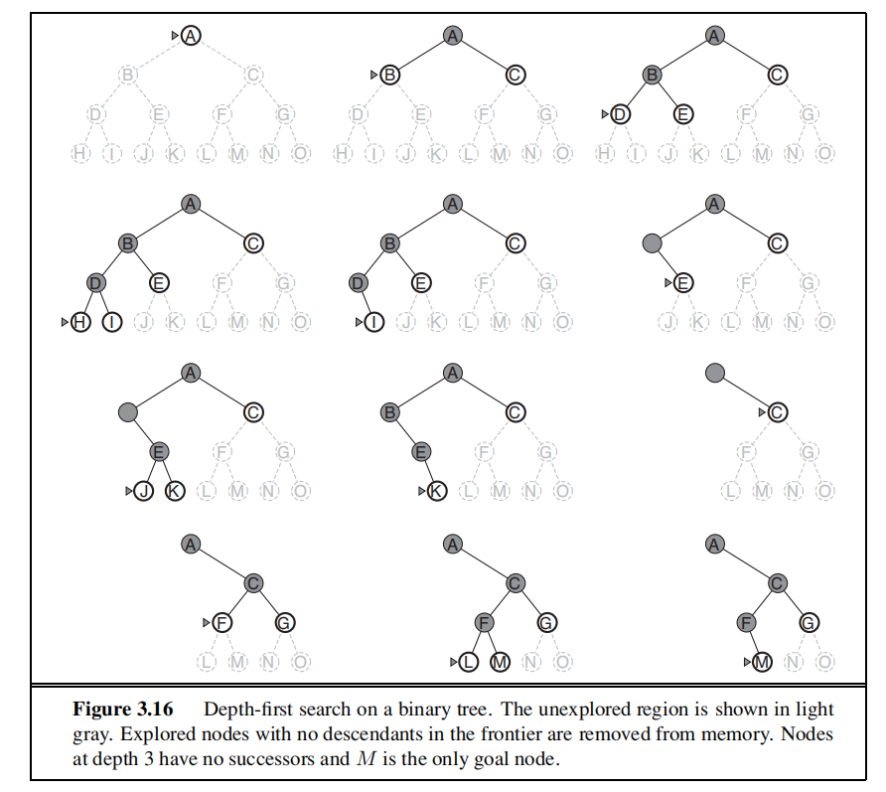

Slide 70
Depth-first search
S
A
D
B
D
A
E
C
E
E
B
B
F
11
D
F
B
F
C
E
A
C
G
14
17
15
15
13
G
C
G
F
19
19
17
G
25

Slide 71
Problem solving performance-DFS
Completeness:
depth-first search is implemented with a recursive function that calls itself on each of its children in turn.
The properties of depth-first search depend strongly on whether the graph-search or
tree-search version is used.
The graph-search version, which avoids repeated states and redundant paths, is complete in finite state spaces because it will eventually expand every node.
The tree-search version, on the other hand, is not complete
Depth-first tree search can be modified at no extra memory cost so that it checks new states against those on the path from the root to the current node;
this avoids infinite loops in finite state spaces but does not avoid the proliferation of redundant paths.
In infinite state spaces, both versions fail if an infinite non-goal path is encountered.

Slide 72
Not optimal
depth- first search will explore the entire left subtree even if node C is a goal node.
If node J were also a goal node, then depth-first search would return it as a solution instead of C, which would be a better solution; hence, depth-first search is not optimal.
Time complexity
depth-first graph search is bounded by the size of the state space
A depth-first tree search, on the other hand, may generate all of the O(b^{m}) nodes in the search tree, where m is the maximum depth of any node; this can be much greater than the size of the state space.
m itself can be much larger than d (the depth of the shallowest solution) and is infinite if the tree is unbounded
Space complexity
a depth-first tree search needs to store only a single path from the root to a leaf node, along with the remaining unexpanded sibling nodes for each node on the path.
Once a node has been expanded, it can be removed from memory as soon as all its descendants have been fully explored.
For a state space with branching factor b and maximum depth m, depth-first search requires storage of only O(bm) nodes.
assuming that nodes at the same depth as the goal node have no successors, we find that depth-first search would require 156 kilobytes instead of 10 exabytes at depth d = 16, a factor of 7 trillion times less space.

Slide 73
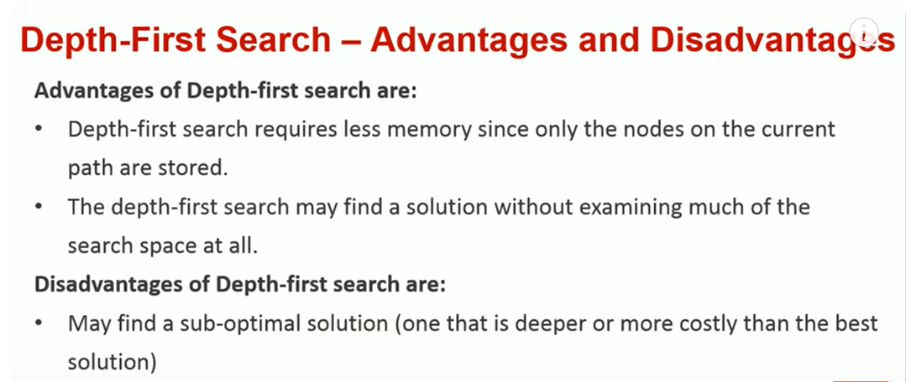

Slide 74
Backtracking search
A variant of depth-first search called backtracking search uses still less memory
only one successor is generated at a time rather than all successors; each partially expanded node remembers which successor to generate next.
Only O(m) memory is needed rather than O(bm).
Backtracking search facilitates the idea of generating a successor by modifying the current state description directly rather than copying it first.
This reduces the memory requirements to just one state description and O(m) actions.
For this to work, we must be able to undo each modification when we go back to generate the next successor

Slide 75
Depth-limited search
depth-first search with a predetermined depth limit l
nodes at depth l are treated as if they have no successors.
The depth limit solves the infinite-path problem.
It also introduces an additional source of incompleteness if we choose l<d, that is, the shallowest goal is beyond the depth limit.
Depth-limited search will also be non optimal if we choose l >d.
Its time complexity is O(b^{l} ) and its space complexity is O(bl )
Depth-first search can be viewed as a special case of depth-limited search with l=∞.

Slide 76
Depth-limited search
It is depth-first search
with a predefined maximum depth
However, it is usually not easy to define the suitable maximum depth
too small → no solution can be found
too large → the same problems are suffered from
Anyway the search is
complete
but still not optimal

Slide 77
Depth-limited search
S
depth = 3
A
D
3
6
B
D
A
E
C
E
E
B
B
F
11
D
F
B
F
C
E
A
C
G
14
17
15
15
13
G
C
G
F
19
19
17
G
25

Slide 78
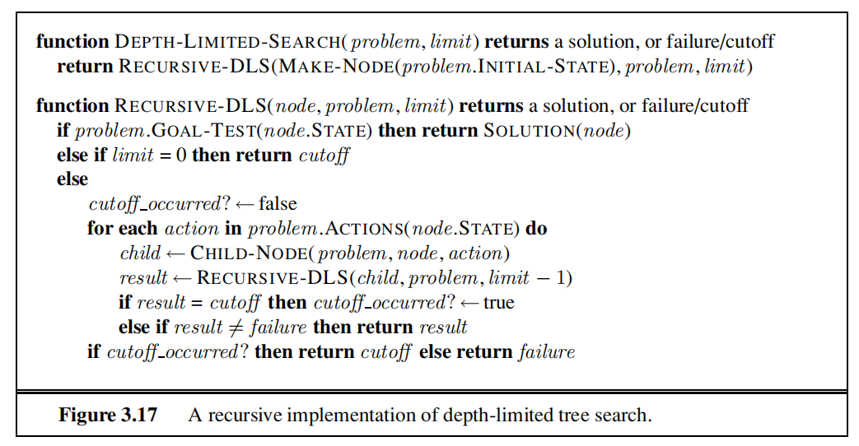

Slide 79
Iterative deepening depth-first search
Iterative deepening search is often used in combination with depth-first tree search, that finds the best depth limit.
It does this by gradually increasing the limit—first 0, then 1, then 2, and so on until a goal is found.
This will occur when the depth limit reaches d, the depth of the shallowest goal node

Slide 80
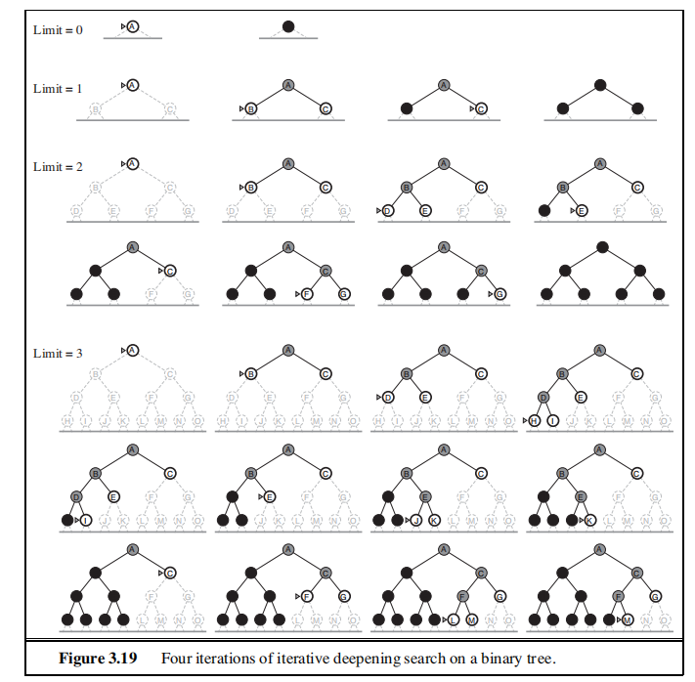

Slide 81
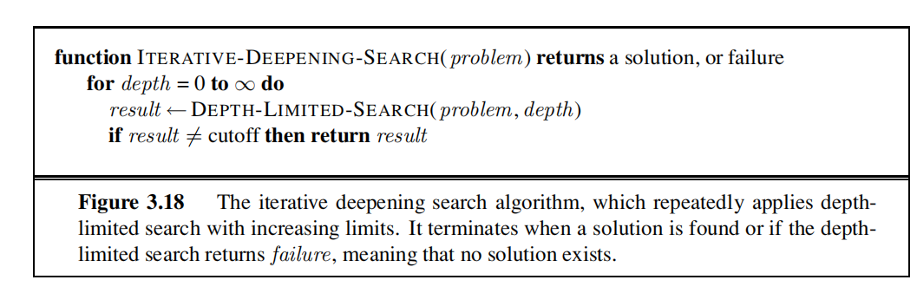

Slide 82
Iterative deepening search may seem wasteful because states are generated multiple times but it is is not too costly.
Because search tree with the same (or nearly the same) branching factor at each level, most of the nodes are in the bottom level, so it does not matter much that the upper levels are generated multiple times
the nodes on the bottom level (depth d) are generated once, those on the next-to-bottom level are generated twice, and so on, up to the children of the root, which are generated d times.
So the total number of nodes generated in the worst case is
N(IDS)=(d)b + (d − 1)b² + ··· + (1)b^{d} ,
which gives a time complexity of O(b^{d}) asymptotically the same as breadth-first search.
Iterative deepening search is analogous to breadth-first search in that it explores a complete layer of new nodes at each iteration before going on to the next layer
iterative deepening is the preferred uninformed search method when the search space is large and the depth of the solution is not known

Slide 83
Complete? Yes
Time? (d+1)b⁰ + d b¹ + (d-1)b² + … + b^{d} = O(b^{d})
Space? O(bd)
Optimal? Yes, if step cost = 1

Slide 84
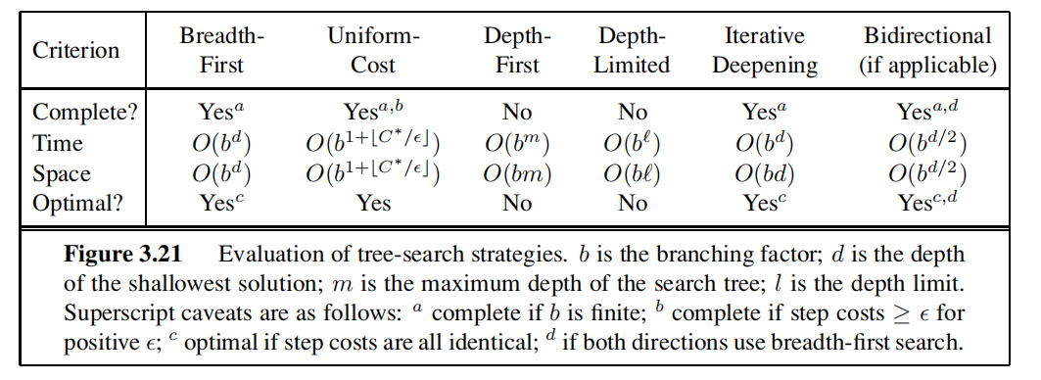

Slide 85
INFORMED (HEURISTIC) SEARCH STRATEGIES
problem-specific knowledge beyond the definition of the problem itself
can find solutions more efficiently than an uninformed strategy

Slide 86
BEST-FIRST SEARCH
Best-first search is an instance of the general TREE-SEARCH or GRAPH-SEARCH algorithm in which a node is selected for expansion based on an evaluation function, f(n).
The evaluation function is construed as a cost estimate, so the node with the lowest evaluation is expanded first.
The implementation of best-first graph search is identical to that for uniform-cost search except for the use of f instead of g to order the priority queue
The choice of f determines the search strategy.

Slide 87
Most best-first algorithms include as a component of f a heuristic function, denoted h(n):
h(n) = estimated cost of the cheapest path from the state at node n to a goal state.
if n is a goal node, then h(n)=0.
For example, in Romania, one might estimate the cost of the cheapest path from Arad to Bucharest via the straight-line distance from Arad to Bucharest.

Slide 88
Greedy best-first search
Greedy best-first search tries to expand the node that is closest to the goal, on the grounds that this is likely to lead to a solution quickly.
It evaluates nodes by using just the heuristic function; that is, f(n) = h(n).

Slide 89
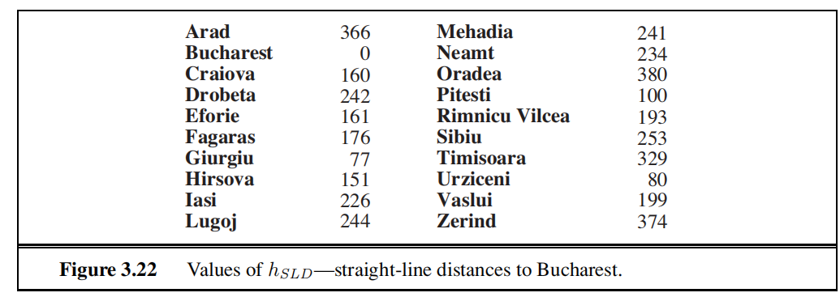
Greedy best-first search- Route finding problems in Romania
straight line distance heuristic, H_{sld}
If the goal is Bucharest, we need to know the straight-line distances to Bucharest
h_{SLD} is correlated with actual road distances and is, therefore, a useful heuristic

Slide 91
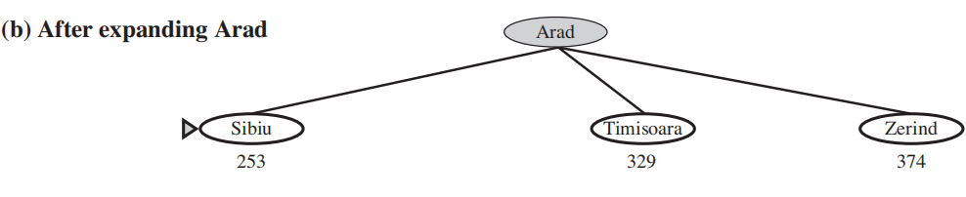

Slide 92
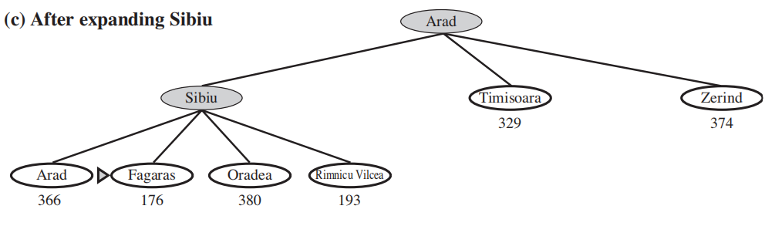

Slide 93
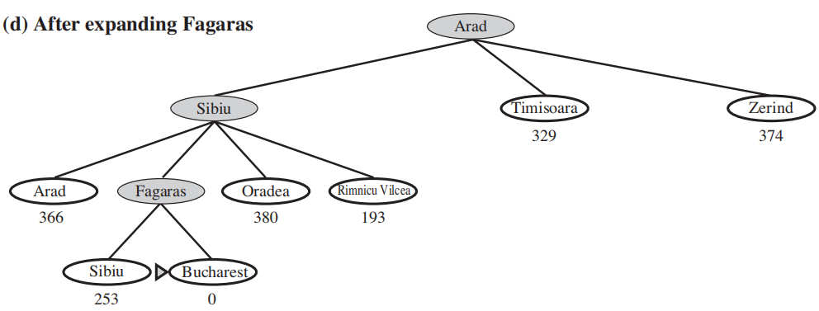
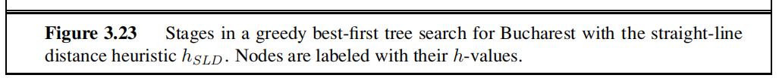

Slide 94
A* search: Minimizing the total estimated solution cost
It evaluates nodes by combining g(n), the cost to reach the node, and h(n), the cost to get from the node to the goal:
f(n) = g(n) + h(n)
Since g(n) gives the path cost from the start node to node n, and
h(n) is the estimated cost of the cheapest path from n to the goal, we have
f(n) = estimated cost of the cheapest solution through n

Slide 95
if we are trying to find the cheapest solution, a reasonable thing to try first is the node with the lowest value of g(n) + h(n).
It turns out that this strategy is more than just reasonable: provided that the heuristic function h(n) satisfies certain conditions,
A∗ search is both complete and optimal.
The algorithm is identical to UNIFORM-COST-SEARCH except that A∗ uses g + h instead of g.

Slide 96
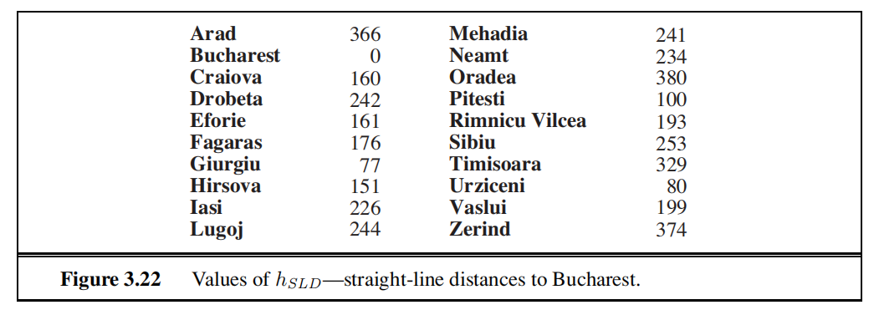
Progress of an A∗ tree search

Slide 97


Slide 98
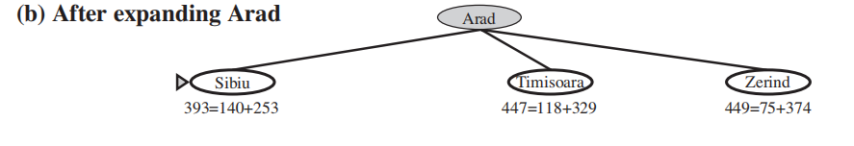

Slide 99
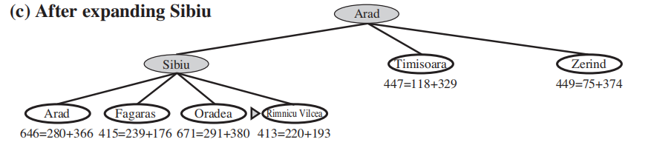

Slide 100
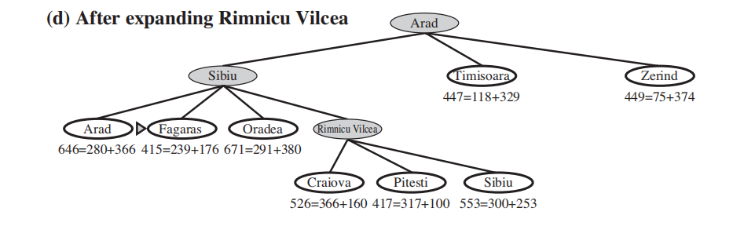

Slide 101
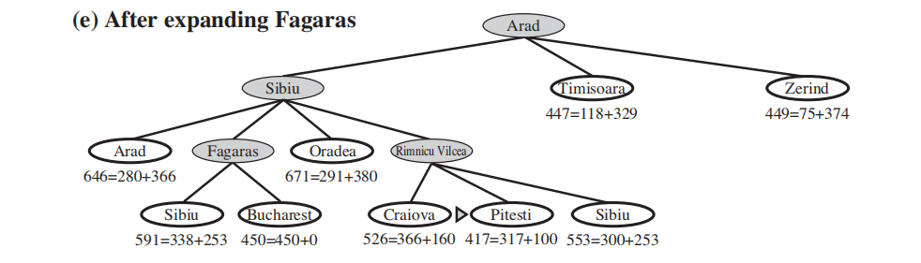
Bucharest first appears on the frontier here but it is not selected for expansion because its f-cost (450) is higher than that of Pitesti (417).
Another way to say this is that there might be a solution through Pitesti whose cost is as low as 417, so the algorithm will not settle for a solution that costs 450.

Slide 102
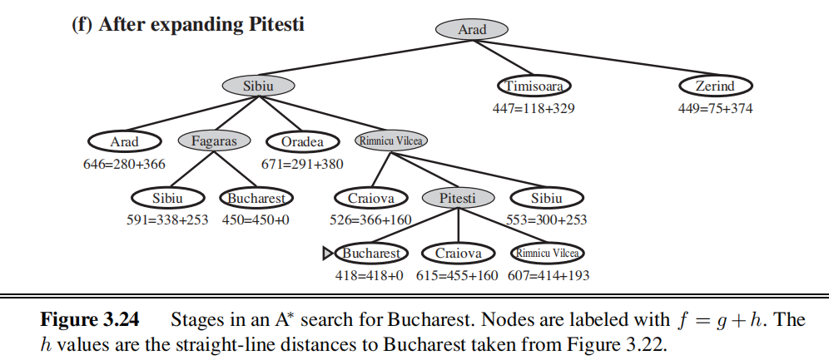

Slide 103
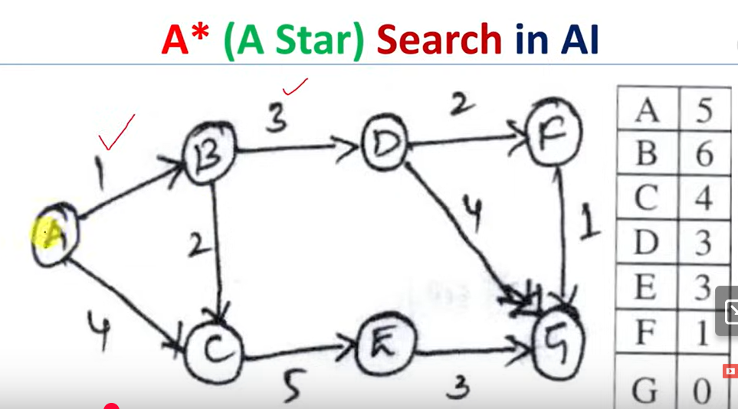

Slide 104
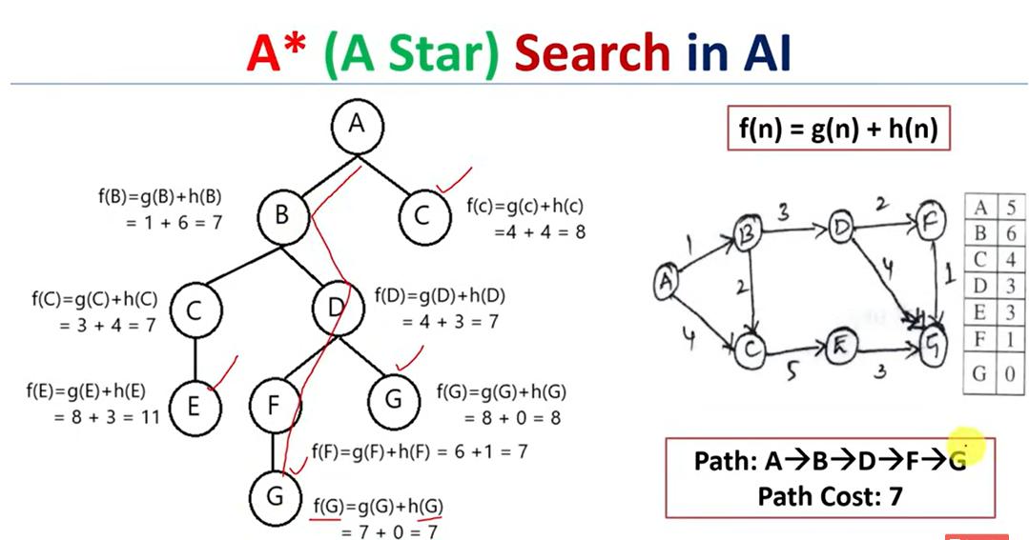

Slide 105
Conditions for optimality: Admissibility
The first condition we require for optimality is that h(n) be an admissible heuristic.
An admissible heuristic is one that never overestimates the cost to reach the goal.
g(n) is the actual cost to reach n along the current path, and
f(n) = g(n) + h(n), we have as an immediate consequence that f(n) never overestimates the true cost of a solution along the current path through n.
Admissible heuristics are by nature optimistic because they think the cost of solving the problem is less than it actually is
Eg, straight-line distance h_{SLD} that we used in getting to Bucharest is n admissible heuristic
because the shortest path between any two points is a straight line
Straight line cannot be an overestimate

Slide 106
Conditions for optimality: Consistency
It is required only for applications of A∗ to graph search
A heuristic h(n) is consistent if, for every node n and every successor n of n generated by any action a, the estimated cost of reaching the goal from n is no greater than the step cost of getting to n plus the estimated cost of reaching the goal from n :
h(n) ≤ c(n, a, n ) + h(n )
This is a form of the general triangle inequality, which stipulates that each side of a triangle cannot be longer than the sum of the other two sides
Here, the triangle is formed by n, n , and the goal Gn closest to n.
For an admissible heuristic, the inequality makes perfect sense:
if there were a route from n to Gn via n that was cheaper than h(n), that would violate the property that h(n) is a lower bound on the cost to reach Gn.

Slide 107
Optimality of A*
the tree-search version of A∗ is optimal if h(n) is admissible, while the graph-search version is optimal if h(n) is consistent.
A∗ expands no nodes with f(n) > C∗—for example, Timisoara is not expanded in even though it is a child of the root
the subtree below Timisoara is pruned; because hSLD is admissible, the algorithm can safely ignore this subtree while still guaranteeing optimality
Pruning eliminates possibilities from consideration without having to examine them
A∗ is optimally efficient for any given consistent heuristic.
That is, no other optimal algorithm is guaranteed to expand fewer nodes than A∗
This is because any algorithm that does not expand all nodes with f(n) < C∗ runs the risk of missing the optimal solution.

Slide 108
if h(n) is consistent, then the values of f(n) along any path are nondecreasing.
The proof follows directly from the definition of consistency.
Suppose n is a successor of n; then g(n ) = g(n) + c(n, a, n ) for some action a, and we have
f(n ) = g(n ) + h(n ) = g(n) + c(n, a, n ) + h(n ) ≥ g(n) + h(n) = f(n) .

Slide 109
whenever A∗ selects a node n for expansion, the optimal path to that node has been found.
Were this not the case, there would have to be another frontier node n on the optimal path from the start node to n
because f is nondecreasing along any path, n would have lower f-cost than n and would have been selected first

Slide 110
the sequence of nodes expanded by A∗ using GRAPH-SEARCH is in nondecreasing order of f(n).
Hence, the first goal node selected for expansion must be an optimal solution because f is the true cost for goal nodes (which have h = 0) and all later goal nodes will be at least as expensive.

Slide 111
Disadvantages of A* Algorithm
the number of states within the goal contour search space is still exponential in the length of the solution.

Slide 112
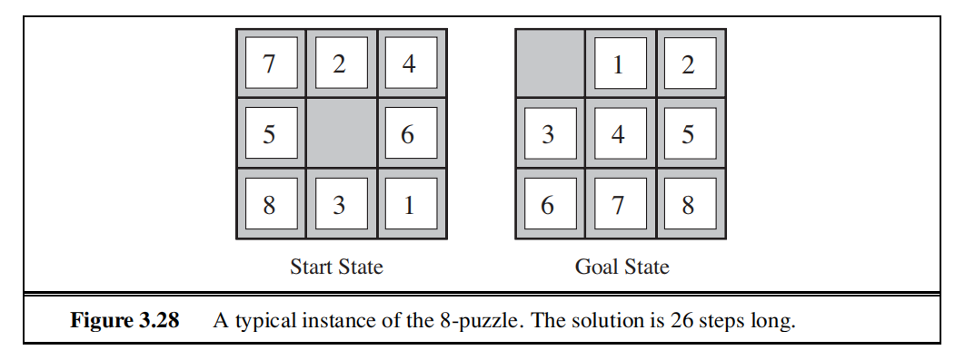
HEURISTIC FUNCTIONS
8-puzzle search space
Typical solution length: 22 steps
Average branching factor: 3
Exhaustive search: 3²²=3.1 x 10¹⁰
Bound on unique states: 9!/2 = 181,440 distinct reachable states
15-puzzle is roughly 1013

Slide 113
Admissible Heuristics
h1 = the number of misplaced tiles.
For Figure 3.28, all of the eight tiles are out of position, so the start state would have h1 = 8. h1 is an admissible heuristic because it is clear that any tile that is out of place must be moved at least once.
• h2 = the sum of the distances of the tiles from their goal positions. Because tiles cannot move along diagonals, the distance we will count is the sum of the horizontal and vertical distances. This is sometimes called the city block distance or Manhattan distance. h2 is also admissible because all any move can do is move one tile one step closer to the goal. Tiles 1 to 8 in the start state give a Manhattan distance of
h2 = 3 + 1 + 2 + 2 + 2 + 3 + 3 + 2 = 18 .
neither of these overestimates the true solution cost,
which is 26.

Slide 114
Inventing Heuristics
Many good heuristics can be invented by considering relaxed versions of the problem (abstractions).
For 8-puzzle: A tile can move from square A to B if A is adjacent to B and B is blank
(a) A tile can move from square A to B if A is adjacent to B.
(b) A tile can move from square A to B if B is blank. (c) A tile can move from square A to B.
If there are a number of features that indicate a promising or unpromising state, a weighted sum of these features can be useful. Learning methods can be used to set weights.

Slide 115
Heuristic Performance
Experiments on sample problems can determine the number of nodes searched and CPU time for different strategies.
One other useful measure is effective branching factor: If a method expands N nodes to find solution of depth d, and a uniform tree of depth d would require a branching factor of b* to contain N nodes, the effective branching factor is b*
N = 1 + b* + (b*)² + ...+ (b*)^{d}

Slide 116
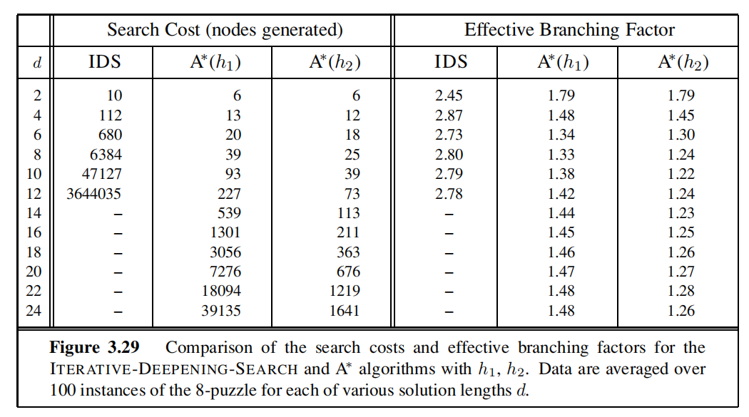
Experimental Results on 8-puzzle problems
1200 random problems with solution lengths from 2 to 24
solved them with iterative deepening search and with A∗ tree search using both h1 and h2
This table show average number of nodes generated by each strategy and the effective branching factor

Slide 117
Quality of Heuristics
Since A* expands all nodes whose f value is less than that of an optimal solution, it is always better to use a heuristic with a higher value as long as it does not over-estimate.
Therefore h2 is uniformly better than h1 , or h2 dominates h1 .
A heuristic should also be easy to compute, otherwise the overhead of computing the heuristic could outweigh the time saved by reducing search (e.g. using full breadth-first search to estimate distance wouldn’t help)

